Slide 1


Slide 2
Quick Tips for Database Performance Tuning
Sergey Koltakov Kurt Engeleiter
Product Manager Product Manager

Slide 3

Historical Performance Problem
An application module was upgraded and deployed.
All went well in the beginning but as the first batch of APAC users came online, the database slowly froze
To fix the immediate problem, the on-call DBA backed out the upgrade and then bounced the database to reset to the previous version.
The development team comes to you and asks for help in diagnosing the problem.

Slide 4




Diagnostic Pack
Snapshots in
Automatic Workload
Repository
Automatic Diagnostic Engine
Self-Diagnostic Engine inside DB
High-load SQL
IO / CPU issues
RAC issues
SQL
Advisor
System Resource Advice
Network + DB config Advice

Slide 5
Tip: Use ADDM to identify and resolve performance problems

Slide 6
Configuration Change Validation
Validate Database Upgrade!
Oracle Database has been upgraded from 10.2.0.4 to 11.2.0.1
Parameter optimizer_features_enable has been left at 10.2.0.4
To fully utilize features of 11.2.0.1 need to update parameter and validate workload
Key SQL have been captured in a SQL Tuning Set.

Slide 7

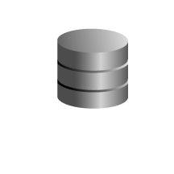

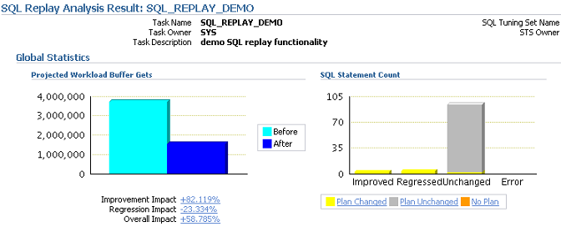
Oracle Real Application Testing – SPA
SQL Workload (STS)
Pre-change executions stats
Post-change executions stats
Compare
SQL Performance
Analysis Report

Slide 8
Tip: Use SPA to test changes to your database environment.

Slide 9
Identifying Regressed SQL Statement
A user has been complaining about application performance.
The on-call DBA was able to find a problematic SQL statement that was taking longer than usual to execute.
He re-runs the statement and emails its Active Report to his senior colleague.
The senior DBA gets an email with the Active Report in the morning and tunes the SQL statement.

Slide 10
Diagnosing Issues with Parallel SQL Statements
DBA would like to investigate a suspicious SQL statement running in parallel.
Examining the Monitored SQL Executions list DBA notices a suspicious SQL statement running in parallel.
Drilling down to the Monitored SQL Execution Details for the statement DBA notices a cross-instance parallel skew.
As he is doing this his pager starts beeping. He saves the PQ Active Report for later analysis and switches to the urgent issue that came up.

Slide 11
Tip: Use Real-Time SQL Monitoring to diagnose issues with long running and parallel SQL statements.

Slide 12
Additional Oracle Enterprise Manager sessions
Wednesday, Oct. 14 | Location
11:45 a.m.- Performance-Testing Oracle E-Business Suite: Tips and Tricks from Oracle Experts 11:45 a.m.- Oracle Enterprise Manager: Monitoring and Security Best Practices 11:45 a.m.- Upgrade Case Study: Database Replay, Snapshot Standby, and Plan Baselines | Moscone S. Room 305 Moscone S. Room 303 Moscone S. Room 301
1:45 p.m.- Quick Tips for Database Performance Tuning 5:00 p.m.- SQL Gone Wild: Taming Bad SQL the Easy Way (or the Hard Way) 5:00pm Oracle Enterprise Manager: Beyond the Basics: Getting More from Oracle Enterprise Manager | Moscone S. Room 104 Moscone S. Room 102 Moscone S. Room 305

Slide 13
The preceding is intended to outline our general product direction. It is intended for information purposes only, and may not be incorporated into any contract. It is not a commitment to deliver any material, code, or functionality, and should not be relied upon in making purchasing decisions.
The development, release, and timing of any features or functionality described for Oracle’s products remains at the sole discretion of Oracle.

